Slide 1
My journal to python
Irish d. deyto
艾芮絲
4110e214

Slide 2
Agenda: learning python
Introduction to python
Python Syntax
Python Data Types
Python Numbers
Python Casting
Python Strings
Python Booleans
Python Operators
Python Lists
Python Tuples
Python Sets
Python Dictionaries

Slide 3
What is Python?
Python is a popular programming language. It was created by Guido van Rossum, and released in 1991.
It is used for:
web development (server-side),
software development,
mathematics,
system scripting.
What can Python do?
Python can be used on a server to create web applications.
Python can be used alongside software to create workflows.
Python can connect to database systems. It can also read and modify files.
Python can be used to handle big data and perform complex mathematics.
Python can be used for rapid prototyping, or for production-ready software development.

Slide 4
Why Python?
Python works on different platforms (Windows, Mac, Linux, Raspberry Pi, etc).
Python has a simple syntax similar to the English language.
Python has syntax that allows developers to write programs with fewer lines than some other programming languages.
Python runs on an interpreter system, meaning that code can be executed as soon as it is written. This means that prototyping can be very quick.
Python can be treated in a procedural way, an object-oriented way or a functional way.
Python Syntax compared to other programming languages
Python was designed for readability, and has some similarities to the English language with influence from mathematics.
Python uses new lines to complete a command, as opposed to other programming languages which often use semicolons or parentheses.
Python relies on indentation, using whitespace, to define scope; such as the scope of loops, functions and classes. Other programming languages often use curly-brackets for this purpose.

Slide 5
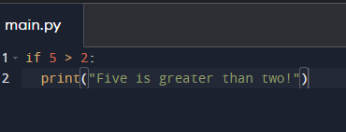

Python Indentation
Indentation refers to the spaces at the beginning of a code line.
Where in other programming languages the indentation in code is for readability only, the indentation in Python is very important.
Python uses indentation to indicate a block of code.
Example:

Slide 6
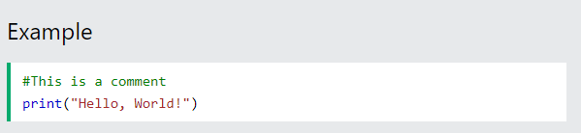
Python Comments
Comments can be used to explain Python code.
Comments can be used to make the code more readable.
Comments can be used to prevent execution when testing code.
Creating a Comment
Comments starts with a #, and Python will ignore them:

Slide 7
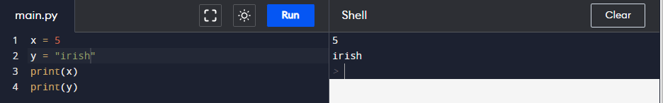
Variables
Variables are containers for storing data values.
Creating Variables
Python has no command for declaring a variable.
A variable is created the moment you first assign a value to it.

Slide 8
Python Data Types
Built-in Data Types
In programming, data type is an important concept.
Variables can store data of different types, and different types can do different things.
Python has the following data types built-in by default, in these categories:
Text Type: str
Numeric Types: int, float, complex
Sequence Types: list, tuple, range
Mapping Type: dict
Set Types: set, frozenset
Boolean Type: bool
Binary Types: bytes, bytearray, memoryview
None Type: NoneType

